Slide 1
PROJECT title: ONLINE BUS TICKET BOOKING SYSTEM
GROUP NO: 31 STREAM B
MEMBERS:
1. 1062811- JULIUS MAINGI NJUGUNA
2. 1062793- NJENGA KENDI
3. 1046045- SHARON CHEPKORIR
4. 1045121- LUCY MWONGELI
5. 1049060- PETER KILUNDA

Slide 2
introduction
An online bus ticket booking system is an online platform that simplifies the process of purchasing bus tickets .it allows users to search for routes, compare prices and book tickets conveniently.

Slide 3
OBJECTIVES:
i) To provide a web-based bus booking system where a customer can buy a bus ticket without the need to queue up at the counter.
ii) To enable customers to check the availability of buses online.
iii) To enable customers to choose their seats online.
iv) To enable customers to pay for their bus ticket online.

Slide 4
Tables
Users seat_reservation
Booking tickets user_cancellation
Payment option feedback table
Routes table Audit logs
Buses table Admin table
Drivers Booked_trips
User_booking_history

Slide 5
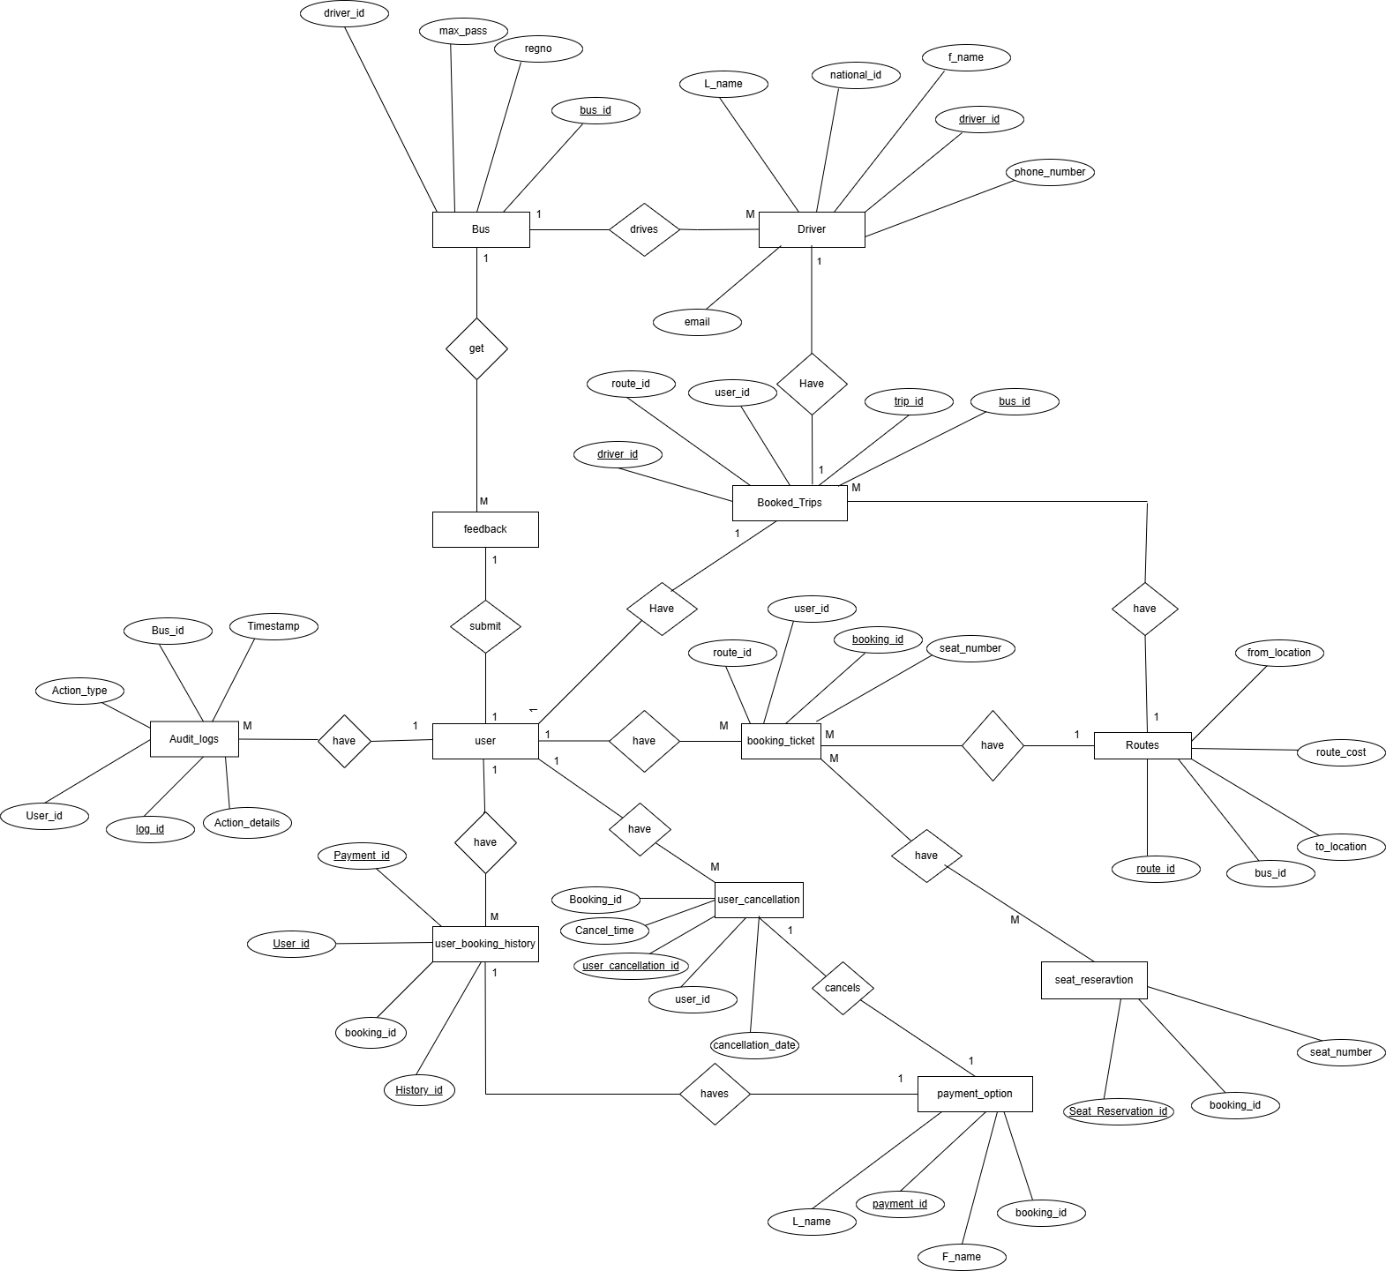
(i) ER- DIAGRAMS

Slide 6
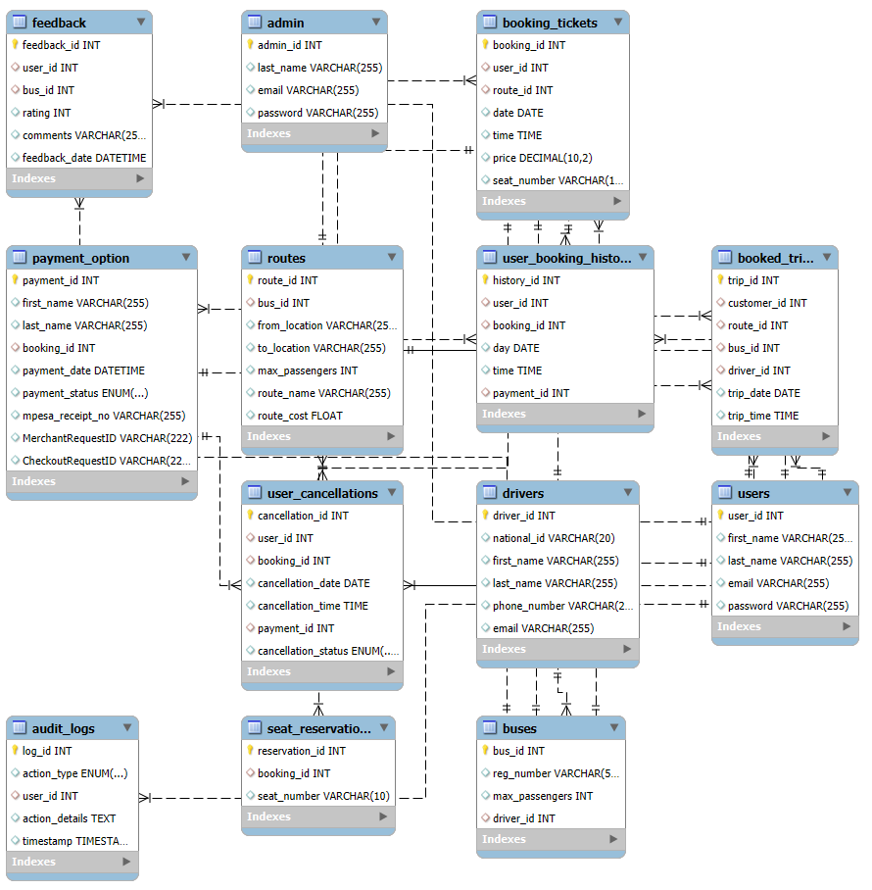
(iii) SQL SCHEMA

Slide 7
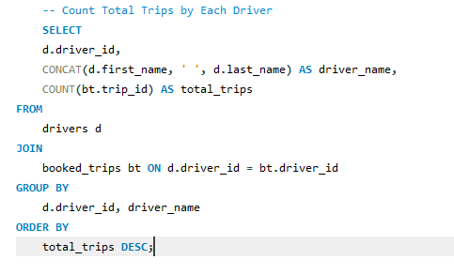
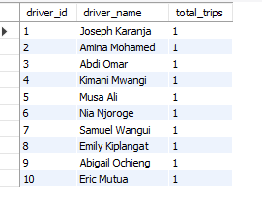
Advanced queries

Slide 8
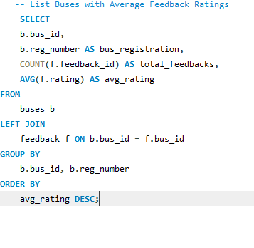
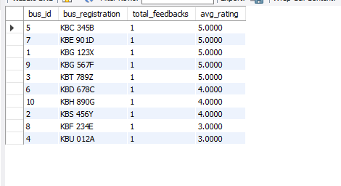
Advanced queries

Slide 9
TESTING AND VALIDATION:
This system has been tested by use of input scenarios, hence ensuring that the constraints, foreign keys and Enums behave as expected.

Slide 10
CONCLUSIONS AND RECOMMENDATIONS:
Conclusions:
This online bus ticket booking system will provide numerous advantages such as enhancing customer satisfaction, smooth operations and increased revenue.
This is because it allows customers to book tickets, select seats, and make payments online, at the comfort of their homes or offices.
The system will also reduce the dependency of customers going to physical booking counters in order to buy a ticket hence making the process more convenient and reliable. Additionally, viewing of seat availability and booking data enables better resource management by reducing operational errors like overbooking.
Overall, the system meets modern customer expectations and will also strengthen the W Transport competitive position in the market.

Slide 11
Future Recommendations:
Offer more Integrated Payment Options: such as credit cards, mobile wallets, and bank transfers, to cater to varied customer preferences.
Real-Time Notifications: Implement notification systems that update customers on booking confirmations, trip reminders, and any changes or delays in schedules.
Offer Promotions: Offer promotional discounts on different seasons to encourage more bookings in the future.
Incorporate Data Analytics: This will enable admins to track and understand the booking trends, popular routes.

